Slide 1


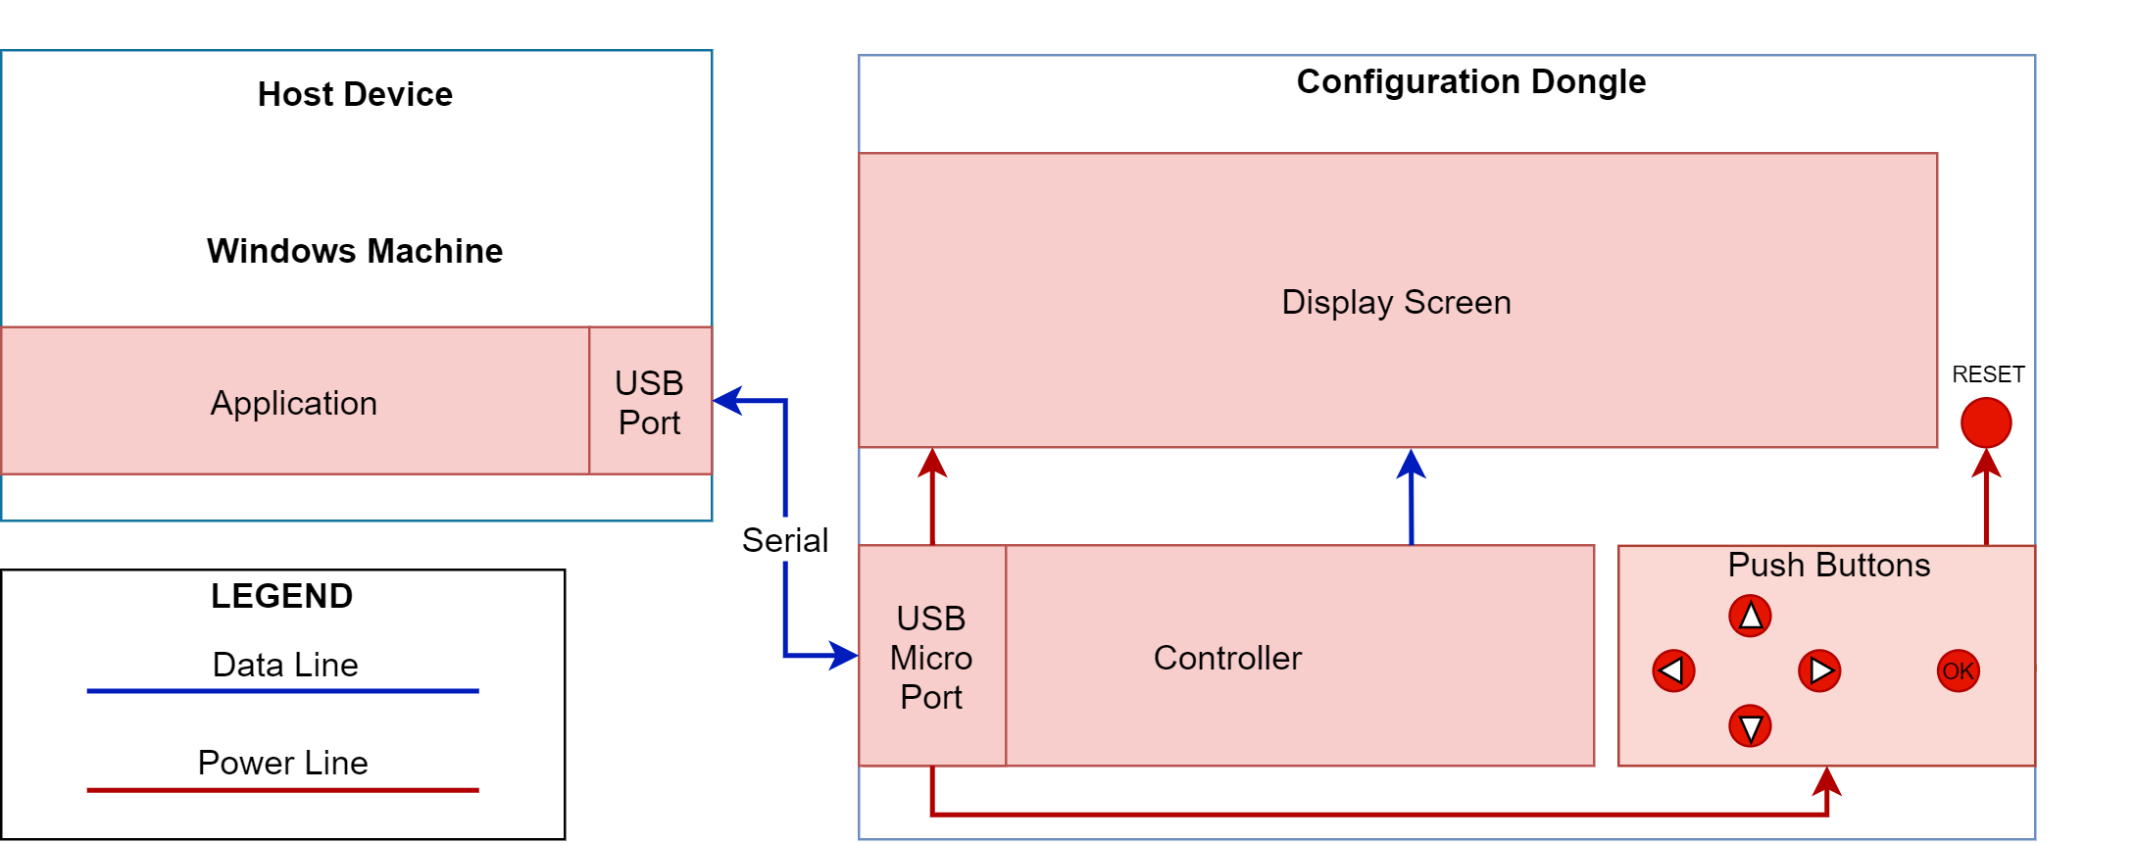

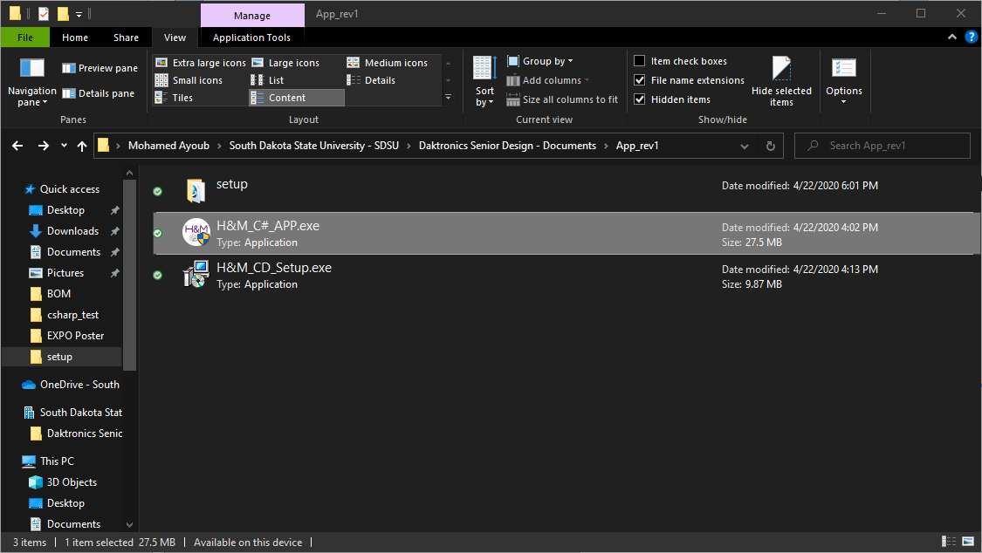
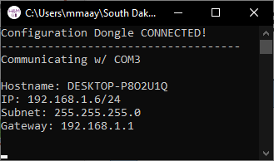
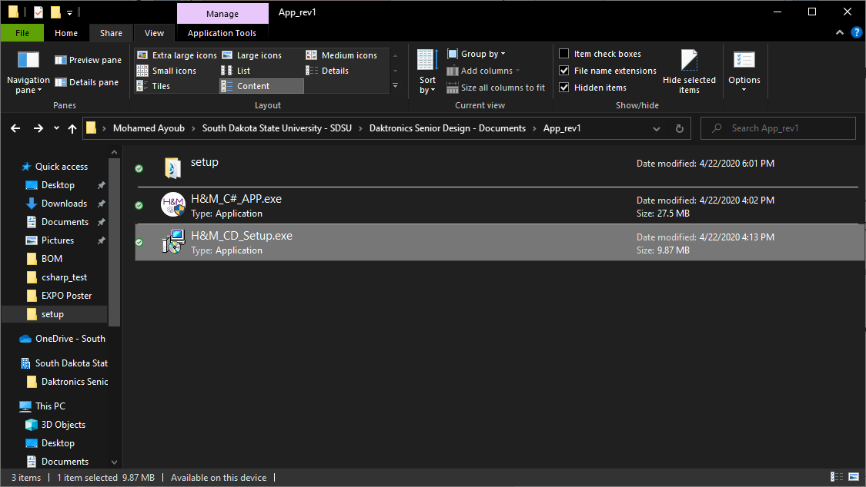
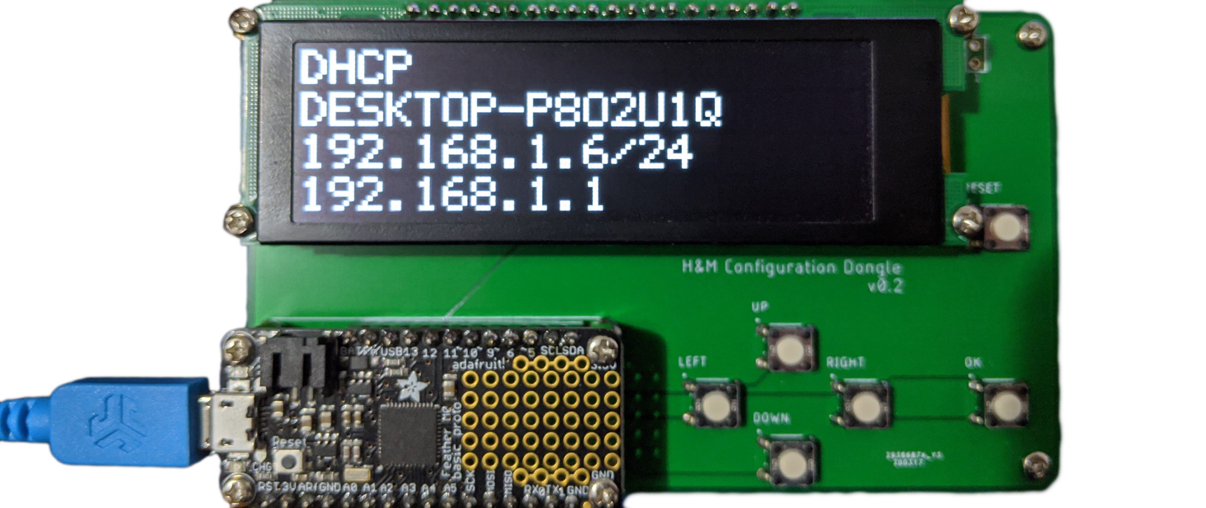
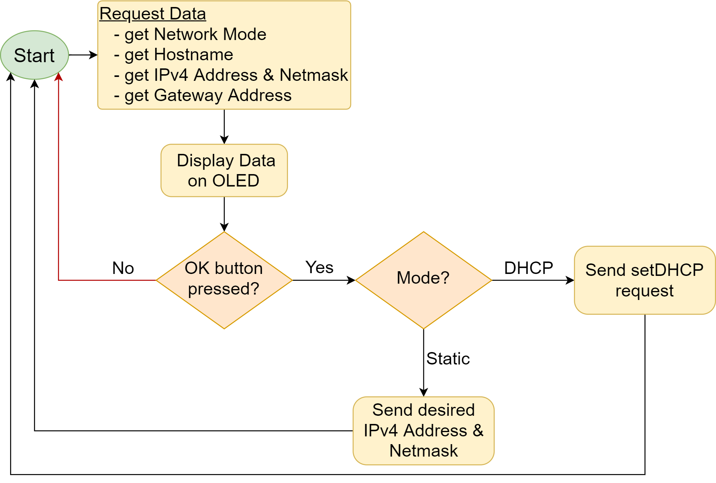
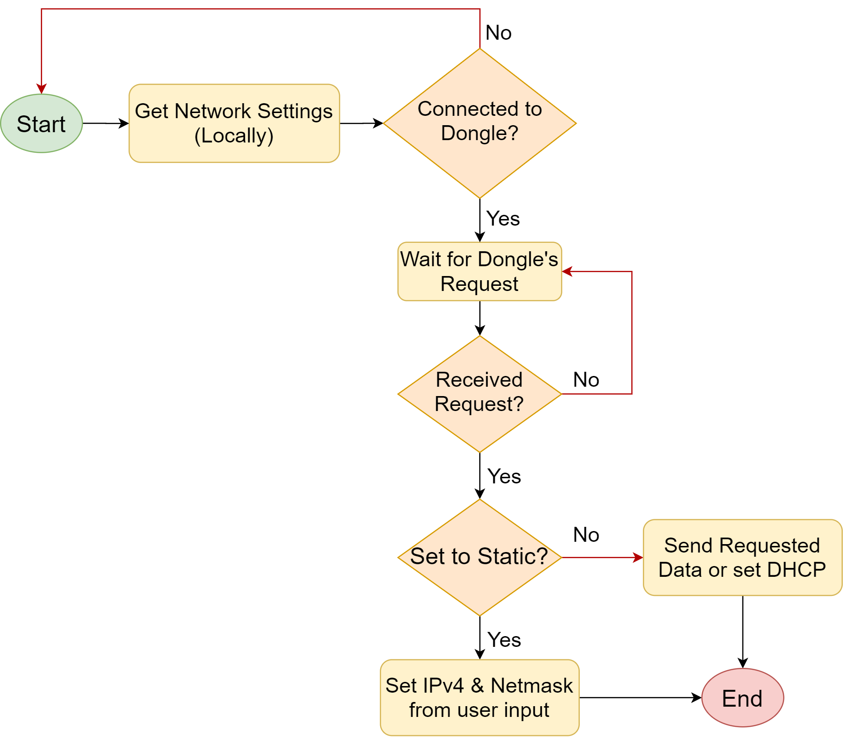
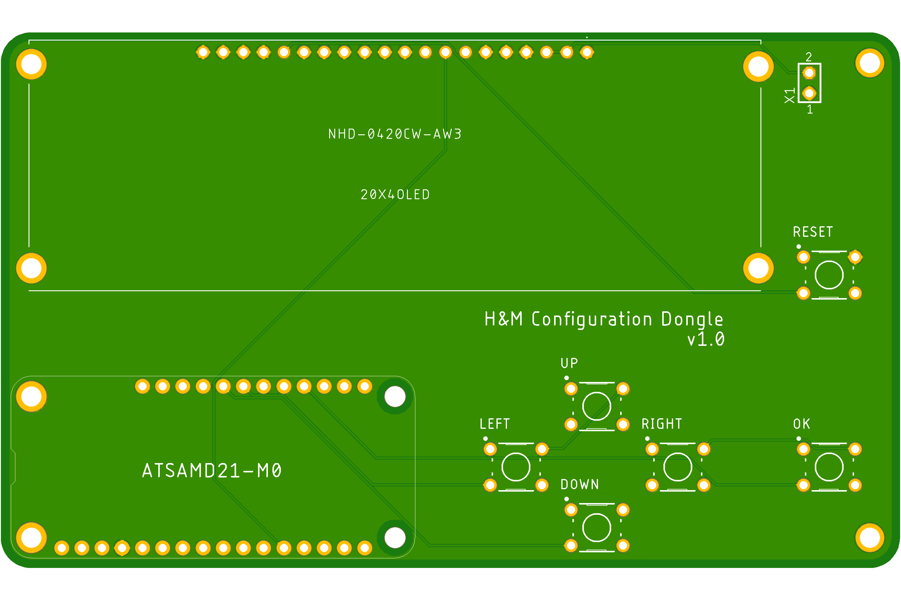
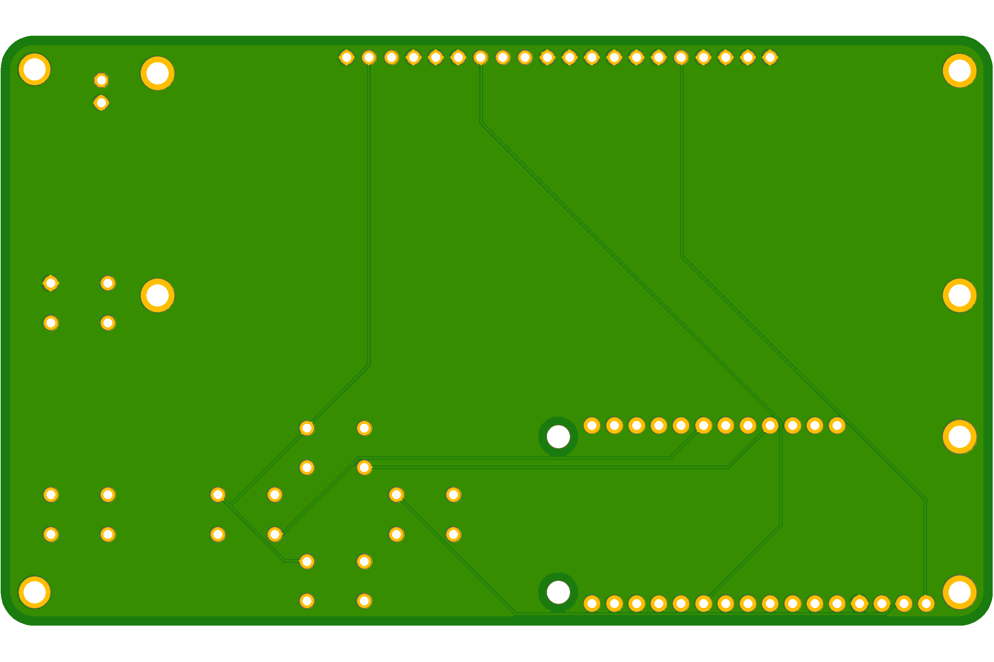
H&M Configuration Dongle
Team Members: Mohamed Ayoub, Harsh Dubey
Advisor: Dr. Fourney
Sponsor: Daktronics (Matt Sickler)
Department of EECS, South Dakota State University
3
Project Objective
Block Diagram
Results
Design a device to gain physical access to the network settings of Daktronics’s display controllers (host device) and to reconfigure these network settings as needed.
Host Device____________________________________
C# application was developed and published into one .exe file.
Network settings are displayed live on the console.
A setup file for the application was developed for easy installation.
The setup file also allows the C# application to lunch upon Windows startup.
Motivation
The display controllers that Daktronics produce are normally accessed over a network using a web browser to configure and control the video displays.
If the network fails or the display controller’s network settings are corrupted, the display controller becomes inaccessible.
Currently when the display controller’s network settings are corrupted, some of them can be recovered using a keyboard and a monitor to configure the network settings using a command-line, other controllers don’t have monitor or keyboard connection and are either thrown away or are reset using complex methods.
Design Solution
On the host device, an application will be developed to retrieve the network settings of the host device and communicate with the microcontroller.
A serial communication protocol will be developed onto the ATSAMD21-M0 microcontroller to communicate with the host device.
An OLED screen will be used to display network mode, hostname, IPv4 address, and gateway address of the host device.
Push buttons will be used to set the network settings of the host device.
Configuration Dongle________________________
Microcontroller was able to display the host device’s network settings on the OLED Screen and configure the network settings using the push buttons.
4.45”
Specifications
Microcontroller Process
.NET C# Application (Host Device)
2.65”
The Configuration Dongle must:
Have at least a 16x2 LCD/OLED display or a matrix OLED display to display the system information and current network settings of the host device.
Have at least 3 push buttons on the right-hand side of the PCB.
Include one USB port.
Be a minimum of 1.5” by 2.5” in size but not larger than 3” by 6”.
Be able to read and write the IPv4 address of the host device under static mode.
Be able to read and write IPv4 Netmask in Classless Inter-Domain Routing (CIDR) format.
Use at least 16-bit Cyclic Redundancy Check (CRC).
Conclusion
All the objectives and specifications of the project have been completed on time and under budget. Additionally, the team developed a PCB for the project and a setup file for the C# program to make the Configuration Dongle easy to use.
Configuration Dongle Design
Future Works
Make host device application compatible with Linux.
Design and build enclosure for the dongle.

